Slide 1
AccuSine PCS+ / PFV+
Launch Presentation
23 January 2015
Jim Johnson
Global Offer Manager

Slide 2
Agenda
The Offer
Technical solution/Architecture
Spec / Feature Review
Launch
Country Dashboard – Forecast and Launch Budget

Slide 3
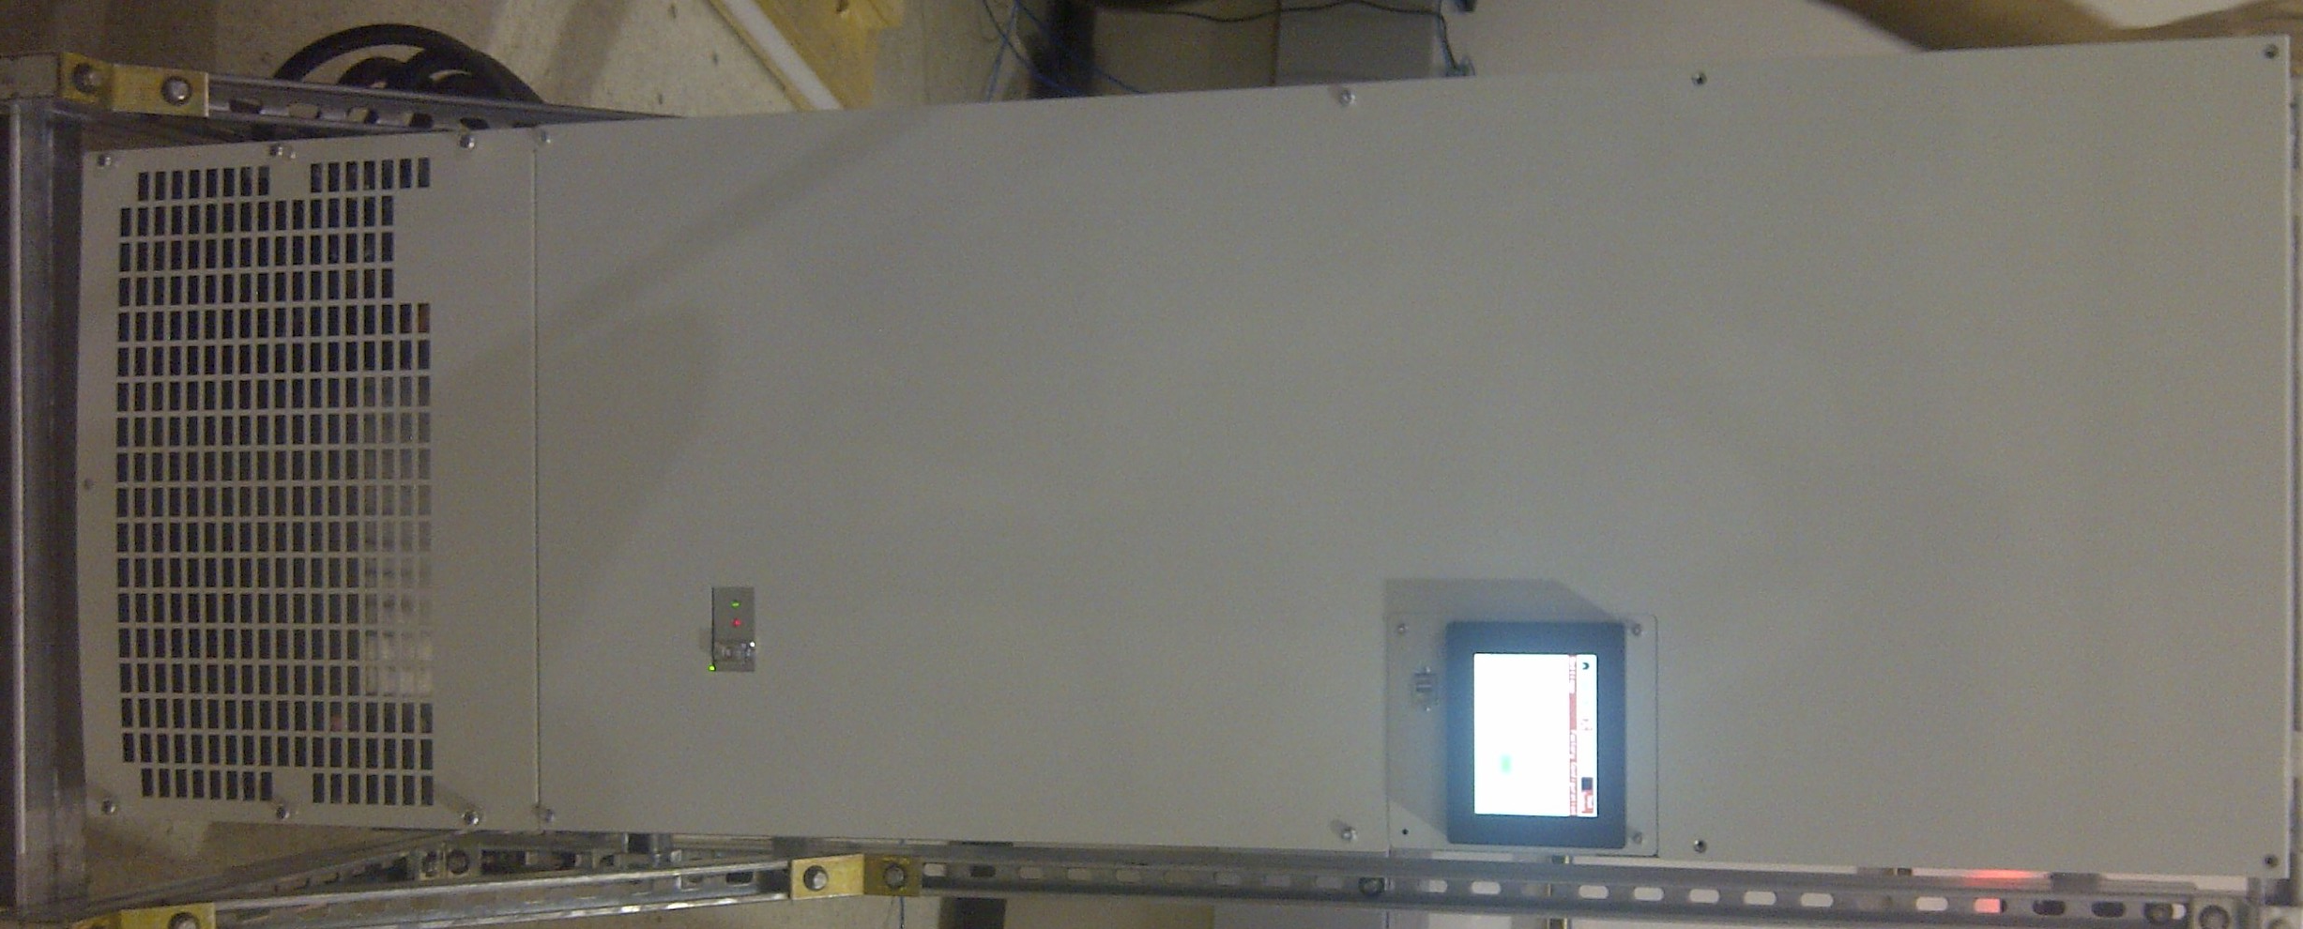
Offer Scope
300 Amp
AccuSine PCS+/AccuSine PFV+
60, 120, 200, and 300 amp models
IP00 for mounting in other’s enclosures
System integrators, MCC, switchgear
IP00 style with EMC compliance
3 phase, 3 or 4 wire, 380-480VAC 50/60Hz
Standard enclosure types:
IP20 & UL Type 1 Wall mount (all sizes)
UL type 2**, IP31, UL Type 12, IP54 Floor standing
Packaging of 600/690VAC, UL Type 2** &12, IP31 and IP54 floor standing
Large HMI (STU type) – 145 mm
Coordination – Model 6 MCC, Okken, BlockSet (all sizes & voltages)
** UL Type 2 is rated for drip proof protection

Slide 4
Offer architecture
Basic frame
IP00
480V PCS+/PFV+
60,120,200,300 Amp
+
500-600V
600-690V
+
Autotransformer
IP31/N2
Enclosure
IP54/N12
Enclosure
IP31/N2
Enclosure
Add Wall Mount KIT => IP20/N1
IP54/N12
Enclosure
Model 6 Okken
Blokset

Slide 5
Offer Scope - Markets
Industry
Industry
Primary
Targets
Data Centers & Networks
Water Wastewater
Oil and Gas
MMM
Renewable Energy
HVAC

Slide 6
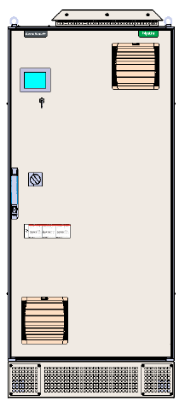
Value Proposition
Water-Wastewater
Simple Consulting Engineer Solution
One solution for many applications
Achieve specified level of THDi/THDv requirements
Cost effective
Space saving
Can be supplied in MCC/Switchgear
Insures performance on backup generator
Improved efficiency (reduced losses)
Lead-lag or load share operation
Fully automated
Modbus TCP/IP or RTU – full communications
Fully Green (ROHs compliant)
Service portal – with or without power
60A IP54/N12

Slide 7
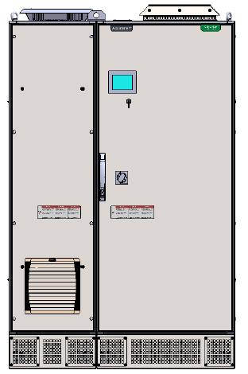
Value Proposition
Oil & Gas
Reduced stress on generators
Increased fuel efficiency
Longer equipment life
Space savings solution
Minimized heat losses
Optimize uptime (OPEX enhanced)
Communications for monitoring, digital control, diagnostics, and set up
Easy solution to apply
Fully Green (ROHs compliant)
Service portal – with or without pow
(Reduced harmonics and increased power factor)
60A IP54/N12 600/690 VAC

Slide 8
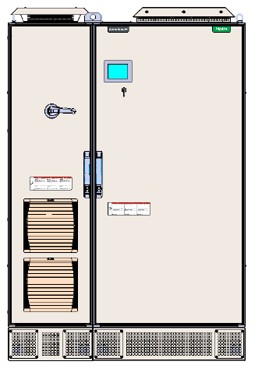
Value Proposition
MMM
Digital communications
Compatibility with VFD loads
Compatible with all types of rectifiers
Compliance to standards
Digital communications: Modbus (RTU & TCP)
Optimized floor space utilization
Best economics: purchase, installation, and operation
Rugged construction
Fully Green (ROHs compliant)
Service portal – with or without pow
300A IP54/N12 600/690 VAC

Slide 9
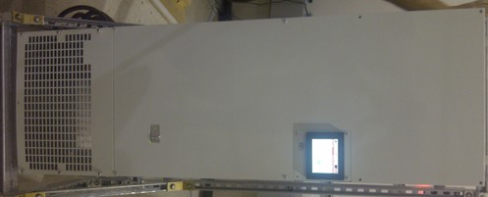
Value Proposition
300A IP00/N1
wall mount
Buildings – HVAC
Simple Consulting Engineer Solution
One solution for all VSD applications
Achieve specified level of THDi/THDv requirements
Cost effective
Space saving
Can be supplied in MCC/Switchgear
Improved efficiency (reduced losses)
Fully automated
Modbus TCP/IP or RTU – full communications
Fully Green (ROHs compliant)
Service portal – with or without power

Slide 10
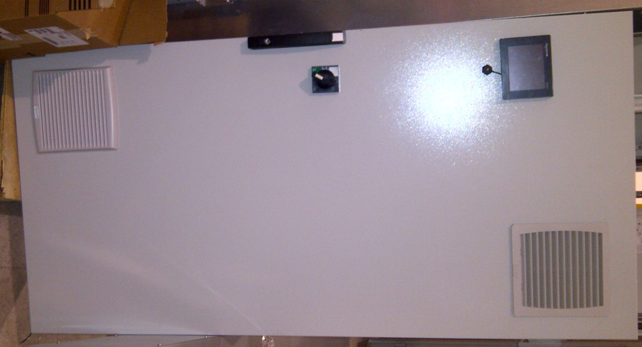
Value Proposition
The CLOUD – server farms
Provide uninterrupted service (makes your customers happy)
Insure server uptime on any power supply
Reduce utility power factor penalties – insures acceptable leading power factor
Digital communications: Modbus (RTU & TCP)
Optimize power source performance
Maximize electrical system utilization
Meet standards
120A IP54/N12

Slide 11
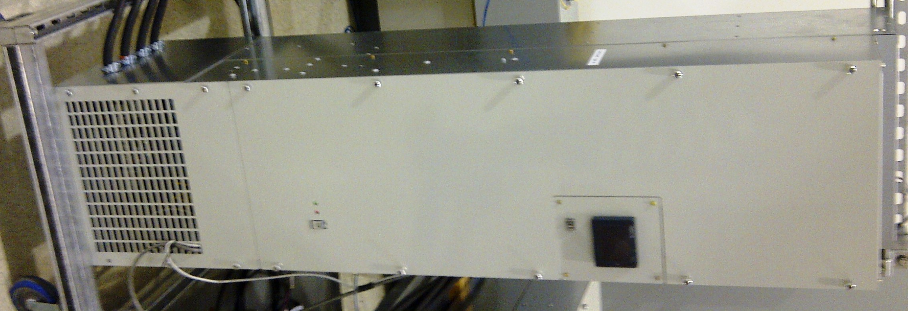
Value Proposition
120A IP20/N1 wall mount
Renewable Energy – PV
Optimize uptime – provides voltage stability that optimizes ability to supply power to utility
Prevents voltage backflow – prevents damage to PV inverters
Fully automated
Modbus TCP/IP of RTU – full communications
Fully Green (ROHs compliant)

Slide 12
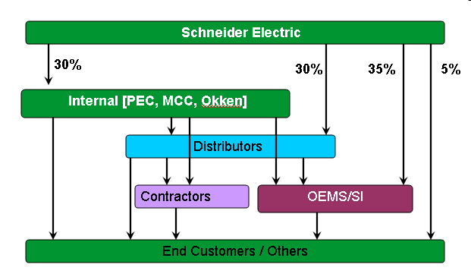
Channels to Market – AccuSine+

Slide 13
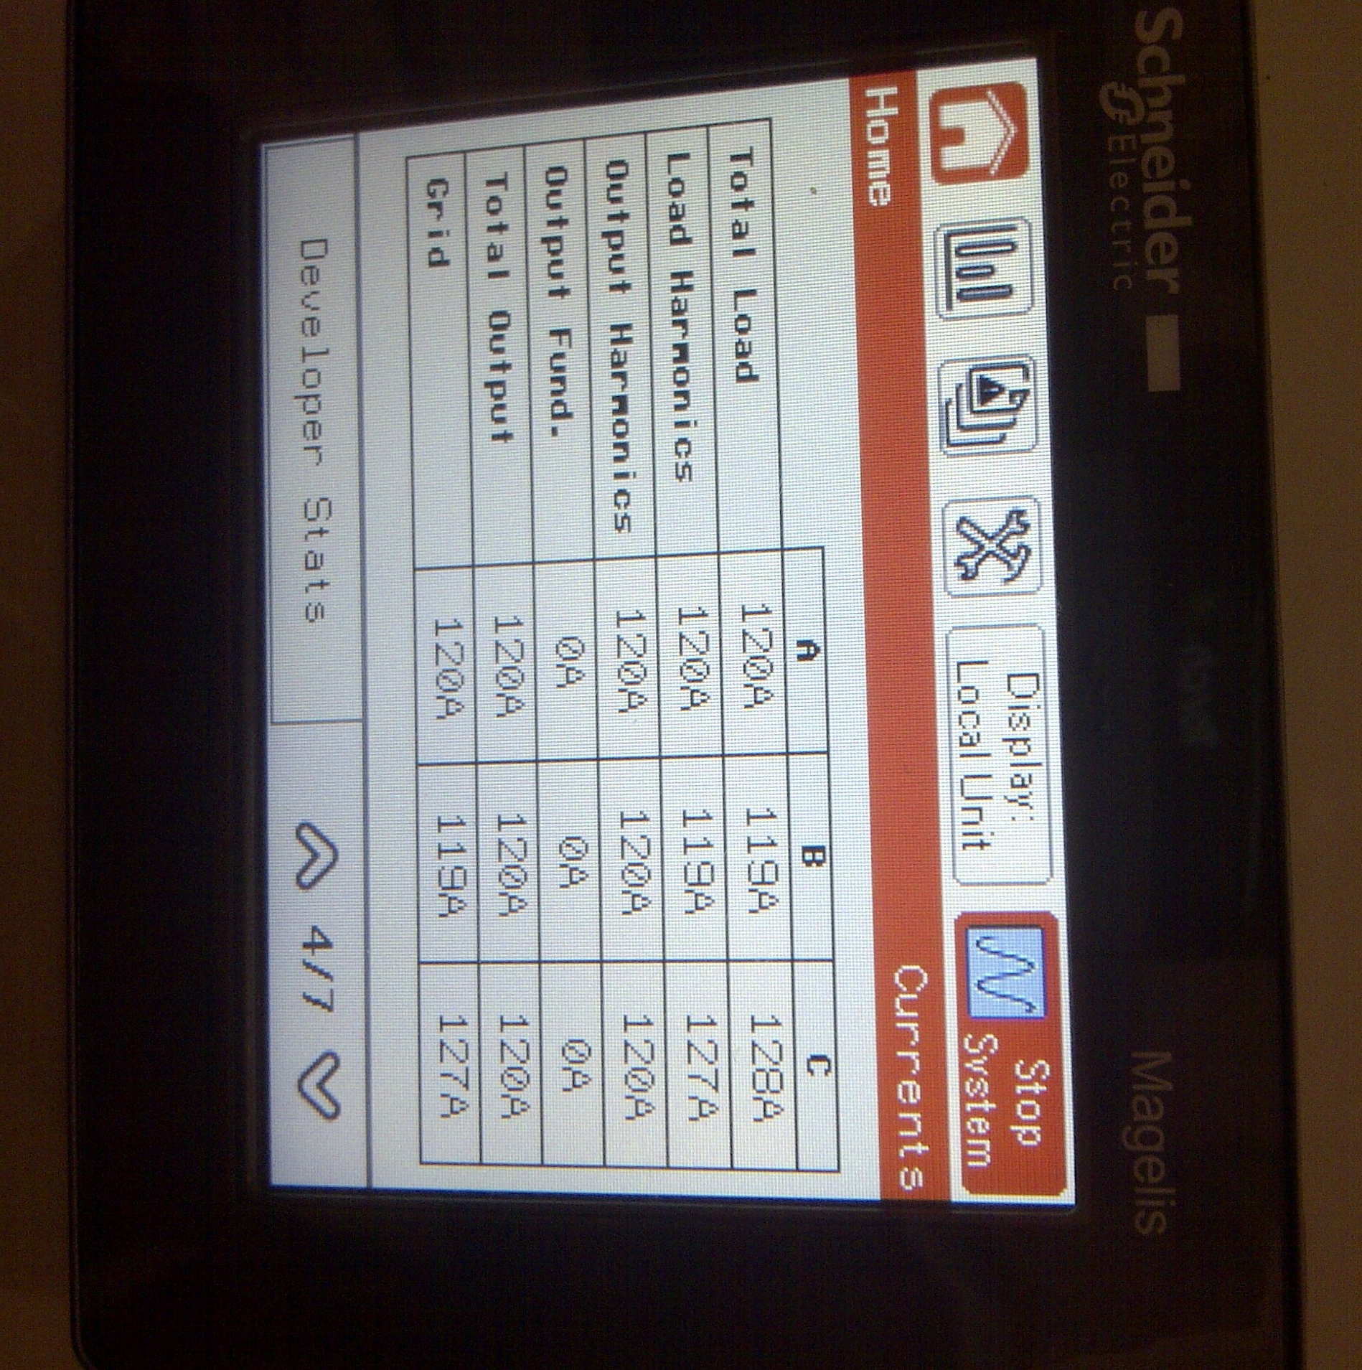
Technical Structure – AccuSine+
IP00 (Chassis)
HMI
Magelis
IGBT
Bus Ass’y
Inductor
EMC Filter Ass’y
Control & Power BD
Air Movers
Contactor

Slide 14
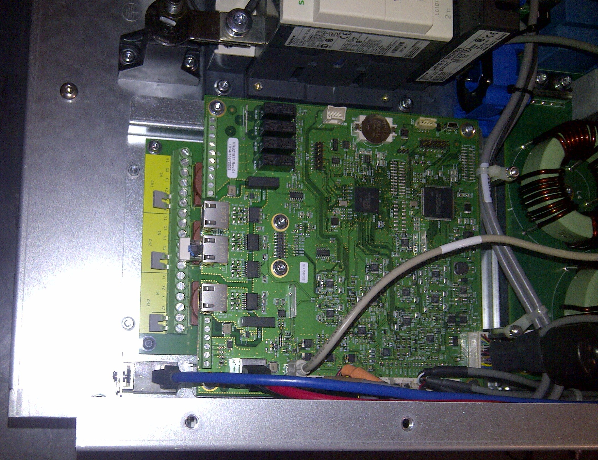
Technical Structure – AccuSine+
Customer Connections
Modbus RTU Port*
Parallel COM Ports*
I/O dry terminals
CT connections
Modbus TCP/IP Port*
*Ports are RJ45 type

Slide 15
AccuSine+ Size Comparison to AccuSine
IP00 (chassis) Size Comparison
 | 60A | 50A |  |  |  |  | 200A
 | New | Old | Volume Reduction | Foot Print Reduction |  |  | New | Old | Volume Reduction | Foot Print Reduction
W | 421 | 526 |  |  |  | W | 575
D | 349 | 470 |  |  |  | D | 435
H | 1300 | 1219 |  |  |  | H | 1323
V | 191007.7 | 301361.2 | 37% | 40.6% |  | V | 330915.4
 | V is kmm³
 | 120A | 100A |  |  |  |  | 300A | 300A
 | New | Old | Volume Reduction | Foot Print Reduction |  |  | New (wall mount) | Old (Floor standing) | Volume Reduction | Foot Print Reduction
W | 421 | 526 |  |  |  | W | 575 | 800
D | 384 | 470 |  |  |  | D | 435 | 500
H | 1400 | 1649 |  |  |  | H | 1560 | 1900
V | 226329.6 | 407665.8 | 44% | 34.2% |  | V | 390195 | 760000 | 49% | 38.5%

Slide 16
Specification/Feature Review
AccuSine PCS
50A, 100A, 300A @ 208-480 VAC 39A, 78A, 235A @ 500-600 VAC 33A, 67A, 200A @ 600-690 VAC
cULus – all but 690VAC models
CE certified – specific models
Enclosures: IP00, IP30, & IP54
UL type – Chassis, 1, 12
AccuSine PCS+
60A, 120A, 200A, 300A @ 380-480 VAC 47A, 94A, 157A, 235A @ 480-600 VAC 40A, 80A, 133A , 200A @ 600-690 VAC
cULus – all (not 690 VAC models)
CE Certified - all models
Enclosures: IP00 (CH) & IP20 (Type 1) – wall mount
IP31, IP54; UL type 2 &12 – Floor Standing

Slide 17
Specification/Feature Review
AccuSine PCS
Ambient Conditions:
Temperature: All assemblies 0°–40°C, derate to 50°C @ 2% per °C
Altitude: to 1000 m; derate 1% per 100 m above
Humidity to 95% Non-condensing
AccuSine PCS+
Ambient Conditions:
Temperature: IP00/20 @ 0°to 45° for 60A to 120A; to 40°C for 200/300A, derate to 50°C @ 2% per °C;
IP31/54 @ 0°to 40°C, derate to 50°C @ 2% per °C
Altitude: to 1000 m; derate 1% per 100 m above
Humidity to 95% non-condensing
PCBA – conformal coated
Absolute shut down when inlet air hits 51°C

Slide 18
Specification/Feature Review
AccuSine PCS
Contamination Class - Operating:
Chemical Class 3C2*
Mechanical Class 3S2**
Storage: Chemical 3C3/Mech 3S3 (in original shipping crate)
*Locations with normal levels of contaminants experienced in urban areas with industrial activities scattered over the whole area or with heavy traffic.
AccuSine PCS+
Contamination Class - Operating:
Chemical Class 3C2*
Mechanical Class 3S2**
Storage: Chemical 3C3/Mech 3S3 (in original shipping crate)
**Locations without special precautions to minimize the presence of sand or dust, but not situated in proximity to sand or dust sources.

Slide 19
Specification/Feature Review
AccuSine PCS
Current transformers:
Primary - 250 to 10,000 amps
Secondary – 5 amps
Accuracy Class – Type1
Frequency response – 400 Hz
Volt-Ampere rating – 5 VA minimum (parallel unit adds 2.5 VA per AccuSine unit + cable resistance)
Cannot be grounded outside AccuSine – cannot share
Quantity required: 2 for 3-wire; 3 for 4-W
AccuSine PCS+
Current transformers:
Primary – ANY amps
Secondary – 1 or 5 amps
Accuracy Class – Type1
Frequency response - 50/60 Hz or 400 Hz
Volt-Ampere rating – 15 mΩ (paralleling adds 0.375 VA (5A) / 0.015 VA (1A) per AccuSine PCS+ unit + cable resistance)
Must be grounded external to AccuSine+ – can be shared
Quantity required: 2 or 3, 3 req’d with 1Ø loads

Slide 20
Specification/Feature Review
AccuSine PCS
Logic:
Analog with digital overlay - DSL
- 2 cycle to inject correction
Reactive current response – 2 cycle to full response (PF or mains balancing)
Open loop
Control Response – 100 µSec
AccuSine PCS+
Logic:
Digital – FFT - 2 cycles to inject correction
Reactive current response – 1/4 cycle to full response (PF or mains balancing)
Closed loop – new installations
Open loop – for retrofits
Control Response – 25 µSec

Slide 21
Specification/Feature Review
AccuSine PCS
Paralleling
Load Share
Independent control
Must run mains CT to all
AccuSine units CTs to all
No make up capacity
To 99 units of any size possible
AccuSine PCS+
Paralleling
Load Share or Lead-Lag
Proprietary CAN+ communications bus
Master-Slave/MultiMaster-MultiSlave
Any unit displays data for all units
and programs/controls system
Provides make up capacity (w/proprietary CAN+ Bus)
Can operate same as PCS for retrofits
To 51st order – limit to10 units

Slide 22
Specification Review
AccuSine PCS
Modes of Operation/Performance
Harmonic spectrum: 2nd to 50th (independently adjustable)
Harmonic THD: 5% TDD (THDi at full load of system)
No neutral cancellation
Reactive (leading or lagging to unity PF)
Mains current balancing (negative sequence)
Partition of harmonic and reactive injection
AccuSine PCS+
Modes of Operation/Performance
Harmonic spectrum: 2nd to 51st (independently adjustable)
Harmonic THD: Closed Loop: <3% THD(i); max 20:1 THD(i) reduction with load harmonic current is above 50% of AccuSine PCS rating
Open Loop: <5% TDD
Set point % THDv
Set point %THDi
No neutral cancellation
Reactive (leading or lagging to unity PF)
Mains current balancing (negative sequence)
Partition of harmonic and reactive injection (negative sequence is reactive current)

Slide 23
Specification/Feature Review
AccuSine PFV
Logic:
Analog or analog with digital overlay (1.25 cycles to complete injection)
Reactive current response – 2 cycle (PF or mains balancing)
Negative Sequence – mains current balancing
Open loop
AccuSine PFV+
Logic:
Digital – Instantaneous PQ
(<1/4 cycle to complete injection)
Reactive current response – 1/4 cycle
Negative Sequence – mains current balancing
Closed loop – new installations
Open loop – for retrofits

Slide 24
Specification/Feature Review
AccuSine PFV
Modes of Operation
No harmonic correction
Reactive (leading or lagging to unity PF) – attain set point
Mains current balancing (negative sequence)
Flicker with analog logic yields 1.25 cycle to inject full correction
AccuSine PFV+
Modes of Operation
No harmonic correction
Reactive (leading or lagging to unity PF) – attain setpoint
Mains current balancing (negative sequence)
Volt-VAR support – inject VARS to raise or lower mains voltage (+/- 20% typical delta VAC)
Flicker mode – Instant P-Q + closed loop with feed forward logic yields <1/4 cycle for injection to full correction

Slide 25
System Integrators and MCC Packaging
Unit rating H x W x D Heat losses
60Amp 1300(51.2) x421 (16.6) x349 (13.7) 1300 w
120Amp 1400 55.1) x421 (16.6) x384 (15) 2900 w
200Amp 1323 (52.1) x575 (22.6) x435 (17.1) 4900 w
300Amp 1560 (61.4) x575 (22.6) x435 (17.1) 7200 w
Dual air channel
High heat (back) – no need for auxiliary fans if plenum open area maintained
Control plenum – all PCBA conformal coated
Could make NM12 package – no filtering req’d for high heat plenum
HMI – large 144 mm - mounting (18mm PB + pin to prevent rotation)

Slide 26
Safety Label Languages on unit – English, Spanish, French
Countries to translate to local language (English literature by 10/2015; Manuals by 10/2015)
Countries to purchase units for launch
PWP – AccuSine PCS/PFV withdrawal
Service parts for up to 8 years
Offer substitution with new product within 4 years of EOC
All DIM units to be substituted as soon as possible (last shipped Oct 2008)
EOC MARCH 2016
CoLa Process + PWP Plan

Slide 27
Thank you for your attention!
Any Questions?

